Slide 1
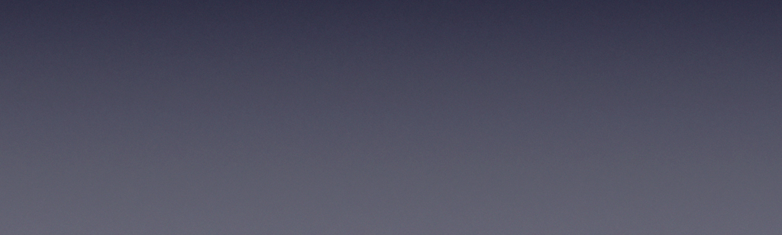

Why you can’t stop watching TikTok？

Slide 2

Recommender systems
Ya Wang, Beyza Ozen
Master of Data Science,
University of Luxembourg

Slide 3
Outline
Introduction and Background
Data Processing
Recommendation with different methods (content-based, KNN, SVD, SGD)
Evaluation and Comparation
Conclusions

Slide 4
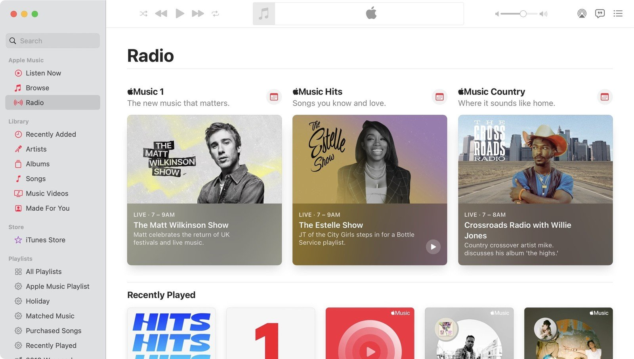
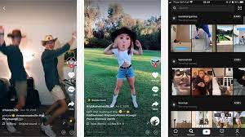

Background
Recommendation systems are widely used in our lives:
YouTube > Videos and Movies
Amazon >goods
TikTok > music video
News Break >News
Provide useful information to users.

Slide 5

1. Introduction

Slide 6
Recommendation System Classification
Collaborative filtering
Only the interaction information between users and products is used for modeling, such as rating information, click and purchase information.
Content-Based Recommendations
Mainly for modeling text and image content. Such as news recommendation.
Hybrid recommendation
Collaborative filtering + content-based recommendation

Slide 7

2. Data Processing

Slide 8
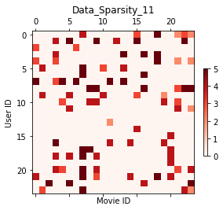
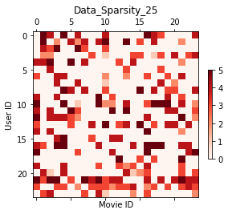
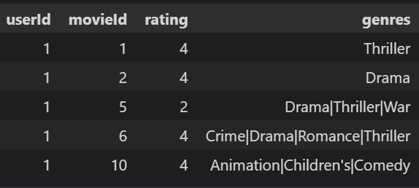
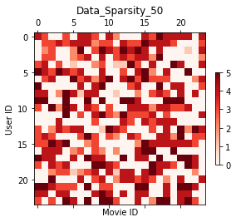
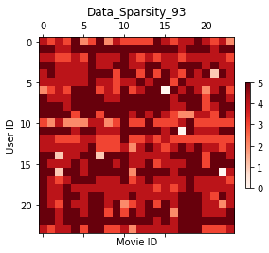
Data Processing
Assumption:

Slide 9

3 Recommendation with different methods
(content-based, KNN, SVD, SGD)

Slide 10
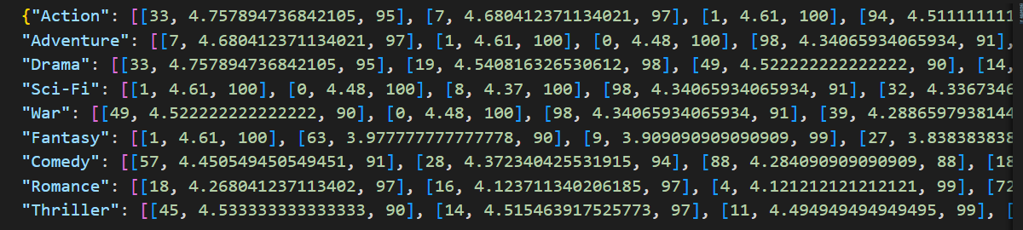
Content-based (matching by genre)
Data-processing
Ranking of movie ratings in different genre
User - Movie Type Preference Matrix
 | Action | Drama | War | Fantasy | Romance
Mike | 15 | 23 | 14 | 4 | 3
Carol | 3 | 11 | 3 | 13 | 3
Max | 14 | 3 | 14 | 3 | 15
Mary | 3 | 13 | 11 | 5 | 4
Jack | 1 | 15 | 5 | 22 | 21
Recommend high-rating movies of favorite genre

Slide 11
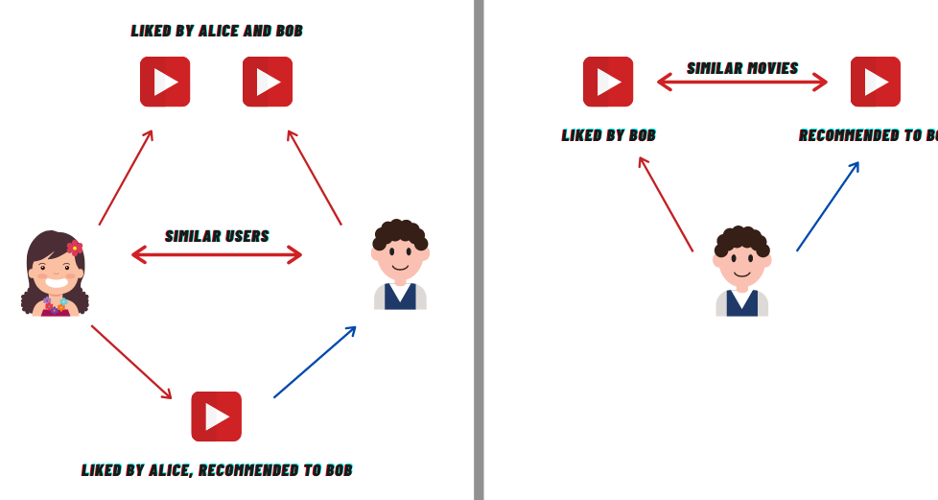
KNN (Distance, K)
Similarity Matrix
Core idea: bird of a feather flock together
user-based nearest neighbor recommendation
movie-based nearest neighbor recommendation
User Movie Rating Matrix
similarity matrix
KNN
Predict ratings for movies users haven't watched
Sort and recommend

Slide 12
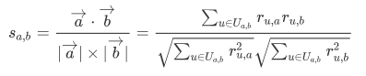



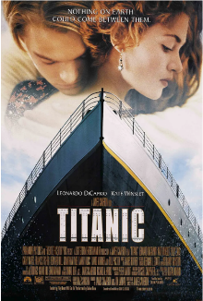
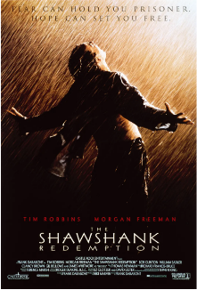
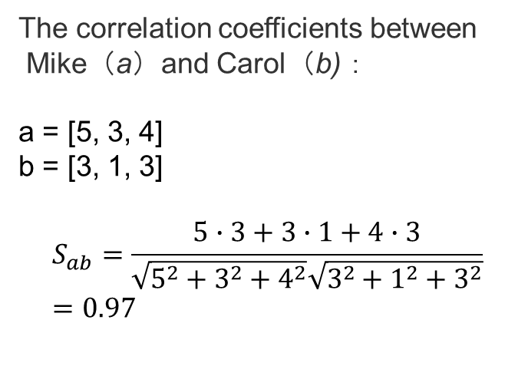
KNN (User similarity Matrix)
The correlation coefficients between
Mike（a）and Carol（b)：
a = [5, 3, 4]
b = [3, 1, 3]
$$S_{ab}=\frac{5∙3+3∙1+4∙3}{\sqrt{5^{2}+3^{2}+4^{2}}\sqrt{3^{2}+1^{2}+3^{2}}}=0.97$$
Cosine Similarity
Mike | 5 | 3 | 4 | 4 | ?
Carol | 3 | 1 | NAN | 3 | 3
Max | 4 | 3 | 4 | 3 | 5
Marry | 3 | 3 | 1 | 5 | 4
Jack | 1 | 5 | 5 | 2 | 1
 | Mike | Carol | Max | Mary | Jack
Mike | 1.00 | 0.97 | 0.82 | 0.94 | 0.99
Carol | 0.97 | 1.00 | 0.94 | 0.85 | 0.74
Max | 0.82 | 0.94 | 1.00 | 0.78 | 0.72
Mary | 0.94 | 0.85 | 0.78 | 1.00 | 0.94
Jack | 0.99 | 0.74 | 0.72 | 0.94 | 1.00

Slide 13
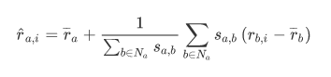
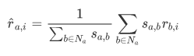
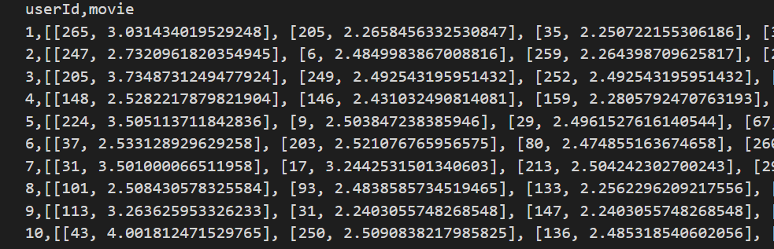
KNN (Predict)

Slide 14
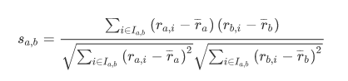
KNN (Movie similarity Matrix)
Pearson correlation coefficient
Mike | 5 | 3 | 4 | 4 | ?
Carol | 3 | 1 | NAN | 3 | 3
Max | 4 | 3 | 4 | 3 | 5
Marry | 3 | 3 | 1 | 5 | 4
Jack | 1 | 5 | 5 | 2 | 1
 | Saving Private Ryan | Spirited Away | WALL-E | Titanic | The Shawshank
Saving Private Ryan | 1.00 | -0.943 | 0.882 | -0.974 | -0.977
Spirited Away | -0.943 | 1.00 | -0.625 | 0.931 | 0.994
WALL-E | 0.882 | -0.625 | 1.00 | -0.804 | -0.7
Titanic | -0.974 | 0.931 | 0.78 | 1.00 | 0.93
The Shawshank | -0.977 | 0.994 | -0.7 | 0.93 | 1.00
mean | 3.2 | 3.0 | 3.2 | 3.4 | 3.25

Slide 15
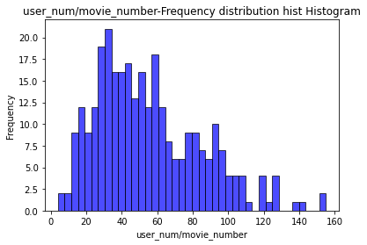
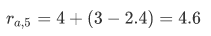
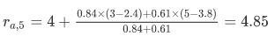
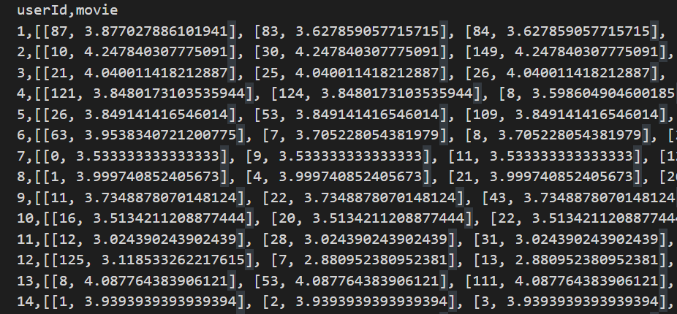
KNN (Predict)

Slide 16
SVD

Slide 17
SGD

Slide 18

4. Evaluation and Comparation

Slide 19
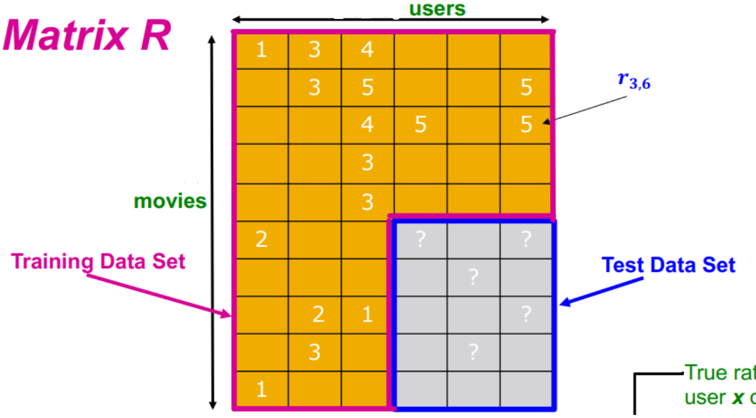
Evaluation and Comparation
 |  | KNN(user) | KNN(movie) | SVD | SGD
Df_11 | MAE | 1.00 | 0.78 | 0.82 | 0.94 | 0.99
 | RMSE | 0.78 | 1.00 | 0.94 | 0.85 | 0.74
Df_25 | MAE
 | RMSE
Df_50 | MAE
 | RMSE
Df_93 | MAE
 | RMSE

Slide 20

5. Conclusions

Slide 21
Conclusions
data sparsity problem
Among millions, tens of millions or even hundreds of millions of products, users only have a few hundred rating records, and there are few overlapping products between users.
Calculate the cost
It is expensive to calculate the similarity between tens of millions or even hundreds of millions of users / items.
Optimal parameters (methods) will be different for different datasets

Slide 22
Thanks for your listening

